Slide 1


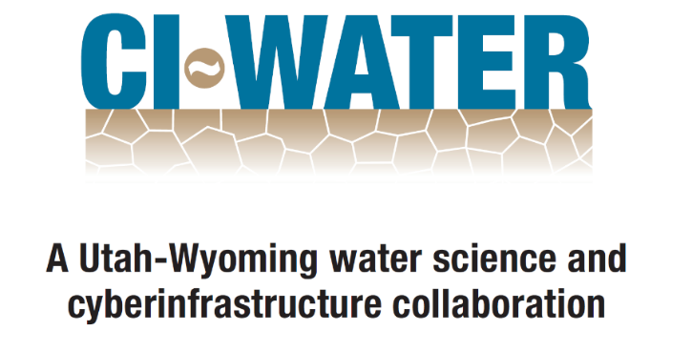


WaM-DaM: A Data Model to Synthesize and Organize Water Management Data
Adel M. Abdallah and David E. Rosenberg
Utah Water Research Laboratory, Utah State University - Logan, Utah, USA
International Environmental Modelling and Software Society (iEMSs) 7th Intl. Congress on Env. Modelling and Software, San Diego, CA, USA
Contributions
Prior Approaches
Further Work
Propose a Water Management Data Model (WaM-DaM) to organize and synthesize network-based water management data
Organize multiple data formats like time series, text, multi-column, and parameters from different sources
Overcome semantic and syntactic heterogeneity in water management data
Foster integrated analysis and understandings of water systems
# | Feature | HEC- DSS | Arc Hydro | ODM | Hydro Platform | WEAP | WaM-DaM
1 | Generic, relational, and open source environment |  |  | x |  |  | x
2 | Create dynamic networks | x | x |  | x | x | x
3 | Uses controlled vocabulary | x | x | x |  | x | x
4 | Enforces descriptive and explicit metadata |  |  | x |  |  | x
5 | Supports multiple data types like time series, tabular, text, and parameters | x | x |  | x | x | x
Populate models and automate the ability to discover, transform, and publish data
How can WaM-DaM organize and serve your water management model data?
Your suggestions and feedback?
Disclaimer: Any opinions, findings, and conclusions or recommendations expressed in this material are those of the author(s) and do not necessarily reflect the views of the National Science Foundation
Follow and participate in WaM-DaM development: https://github.com/amabdallah/WaMDaM

